Slide 1
FBX to Azul Converter

Slide 2
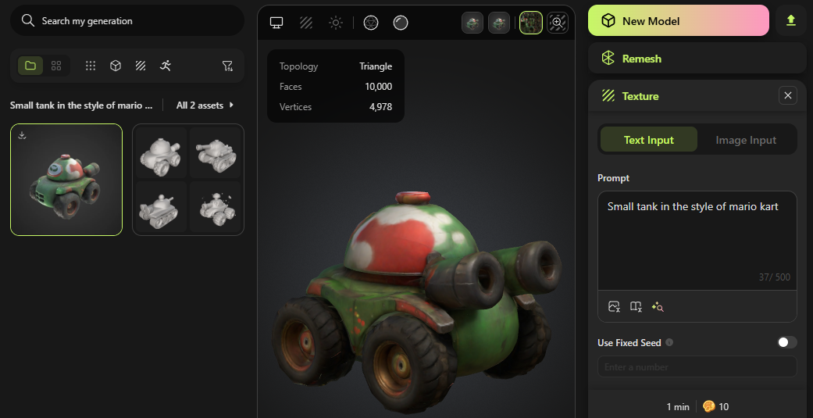
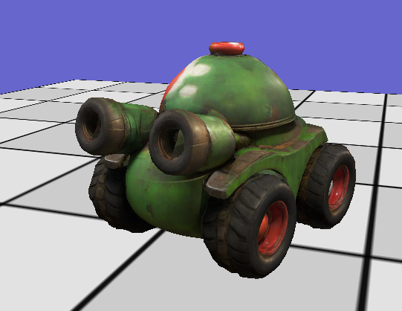
Getting FBX models
DIY with Maya, Blender, etc.
Requires artistic skills and experience with 3D modelling software.
Search online for free (ex: Free3D)
You get what you pay for and likely requires some post-processing 3D modelling software.
AI Assisted? (Ex: Meshy)
Most ‘free’ versions have very limited options and/or requests.
Fiddly. Variable quality and still requires some post processing for alignment/position
May require re-saving as FBX from 3D modeling software to be ‘accepted’ by converter
Fiddly and likely requires some post-processing, but can work.

Slide 3
Converting from FBX to Azul
In “Reference/FBX Converter”, you will find the executable
DO NOT COPY IT! Work in that folder only!
Copy your fbx files in this folder and open a command window there.
Type: (piping the output to a log file greatly speeds up the conversion process)
You now have a file chair.azul ready to be used.
Copy this .azul file into you’re the asset folder of your project.
DO NOT SAVE YOUR EXPERIEMENTS ON PERFORCE!
Just keep the final .azul files you’ve selected for your project

Slide 4
Converter Limitations
This is an in-house converter with some serious limitation. YMMV…
It should work for simple models without skin, animation, bones, etc.
Many details are up to the artist:
Ex: chest.azul points upwards, chair.azul is… not right…
In a real game setting, these models would need to be realigned and rescaled properly to match our engine’s standards for ‘forward’ and scale.
Texture uv vary for different environments. DX has uv’s 0,0 in the upper left but other environments have it in lower left.
You may need to flip the textures vertically to have the uv line-up
BEWARE OF TEXTURE SIZE! Many original textures are 2048x2048 (16MB) or worse! Most of the time, you’ll get the same visual quality at much lower resolution…
Beggars can’t be choosers. The converter is all we have right now to get models in azul format.
Work within its limitations

